Slide 1
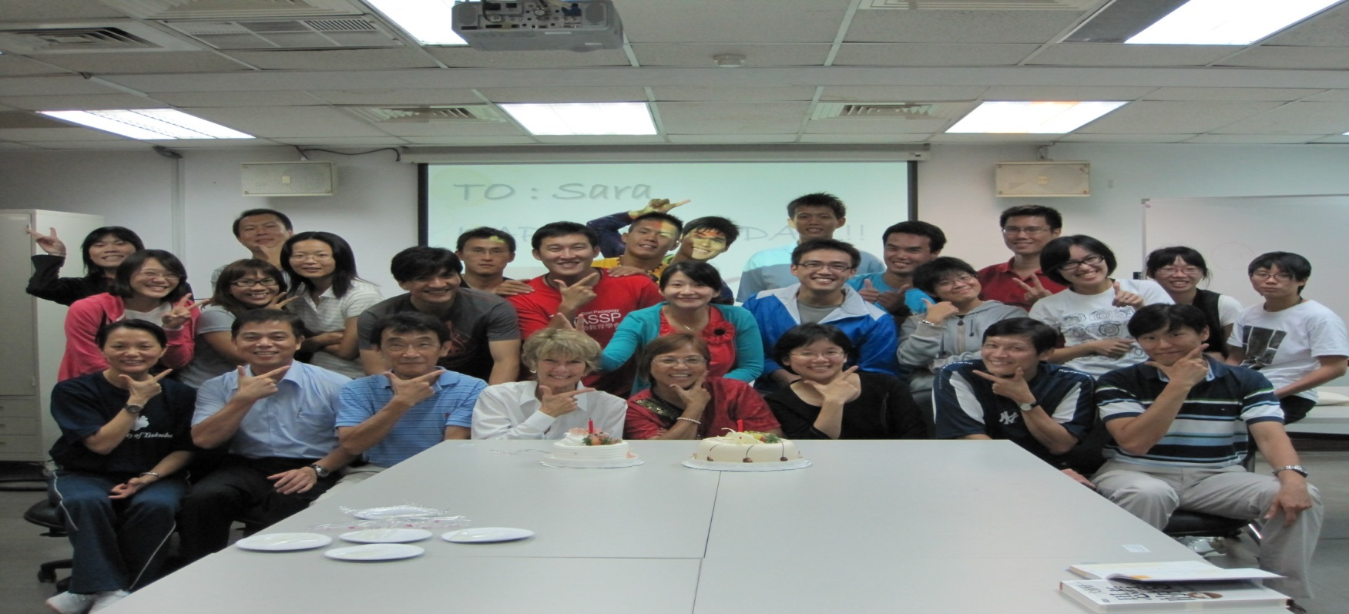
A
B
C
D
E
F
G
H
I
J
K
The Practical Experience of Teaching the Spectrum of Teaching Style in PETE
Robin, Deng-Yau Shy
National Taiwan Normal University

Slide 2
Locations in Taiwan
Taiwan
A combined area of 36,193 square kilometres
Taipei 101 is impossible to miss.
Taiwan mixes urban and nature.
Tons of technology.
With 23.45 million inhabitants, Taiwan is among the most densely populated countries in the world.
Notes:
101大樓: it’s the tallest building in Taiwan and landmark skyscraper.
台灣兼具都會及自然特色Taiwan mixes urban and nature:
There are many tourist attractions in Taiwan you probably don’t want to miss. Taroko Gorge is one of them!
生產的科技Tons of technology : You may not know it, but some brands you’ve been using are from Taiwan, including Giant and HTC!

Slide 3
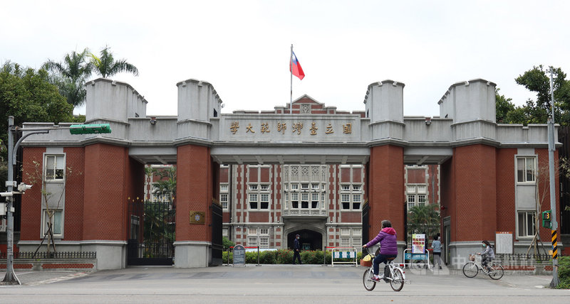
NTNU in Taipei
The first university with a department of physical education in Taiwan
The first College of Education in Taiwan.
NTNU was established in 1922(A century)

Slide 4
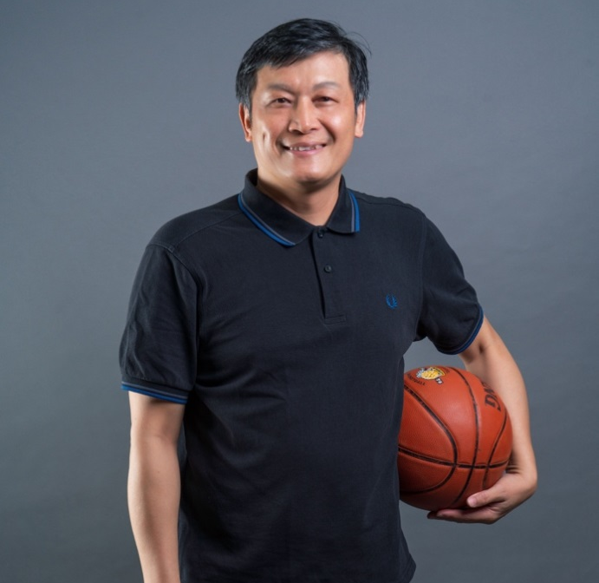
Shy Deng-Yau, Robin
National Taiwan Normal University -PH. D.
Deutsche Sporthochschule Köln -Post Doctoral research
-Visit scholar
National Taiwan Normal University –Associate Professor
Junior High School –Physical Education Teacher for 5 years
MOE Vocational Senior High School Health and Physical Education Domain Curriculum Guidelines of 12-Year Basic Education –Convener
MOE Health and Physical Education Domain Curriculum & Instruction Consulting Team –Board Member
Spectrum Institute for Teaching and Learning–Board Member, Vice President
Taijiguan – Instructor, Coach, Referee
Basketball – Instructor, Coach, Referee

Slide 5
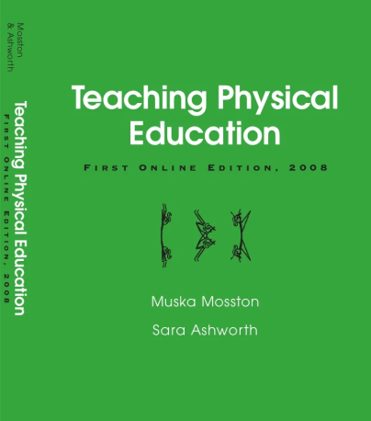
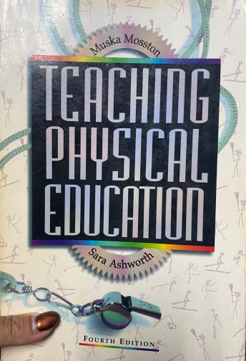
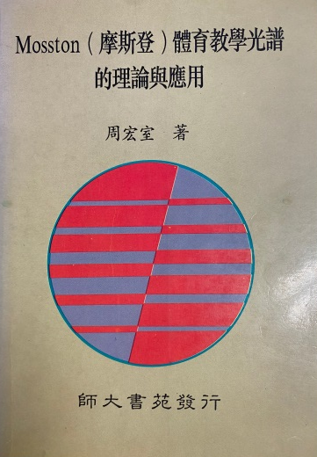
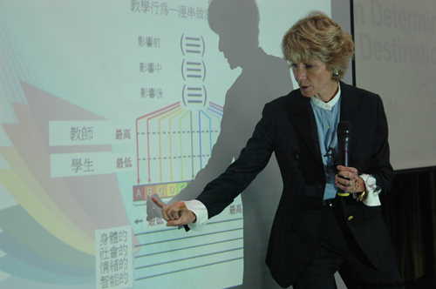
When Robin meet Spectrum…
used spectrum in PETE…
meet spectrum…
1995
2000
Now
1996
2010
used spectrum in sport course…
Sara came to NTNU…

Slide 6
How to become a official teacher in Taiwan
PE Teacher’s recruitment test
Get a teacher's license
Teaching Practicum
National Teacher
Proficiency Test
Take the Professional education courses
Get the qualification of Teacher Education Program

Slide 7
Admission and Qualification
First stage of qualification
Freshman
Cultivate professional Physical education ability.
Qualify for Teacher Education Program(Top 70% )
Officially qualified
After that, The top 40% get formal qualification.
Take the Professional education and the physical education courses
Sophomore
Teaching Practicum: Physical Education(I)
Lesson Plan of Physical Education
Intern teacher(Just observation)
Junior
Teaching Practicum: Physical Education(II)
Intern teacher(Teaching)
Preparing for the Teacher Qualification Exam
Senior

Slide 8
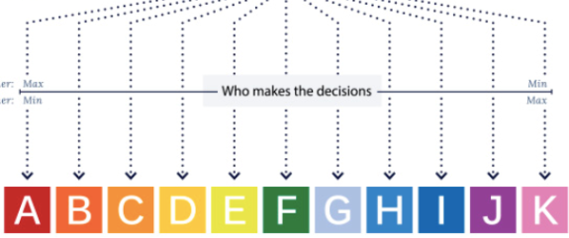
PETE Programmes in NTNU
Undergraduate Program
(128 credits)
Professional Program
(76 credits)
Mosston’s Teaching Spectrum
General education courses
(28 credits)
Department required courses
(46 credits)
Professional Program in PE
(50 credits)
Sport Pedagogy
Professional Program in Education
(26 credits)
PE Teaching Practicum
PE Teaching Materials & Methods
Other elective courses
(33 credits)

Slide 9
PETE Programmes in NTNU
sophomore
Junior
Senior
Sport Pedagogy
PE Teaching Materials & Methods
PE Teaching Practicum
Storage
Retrieval
Transformation

Slide 10
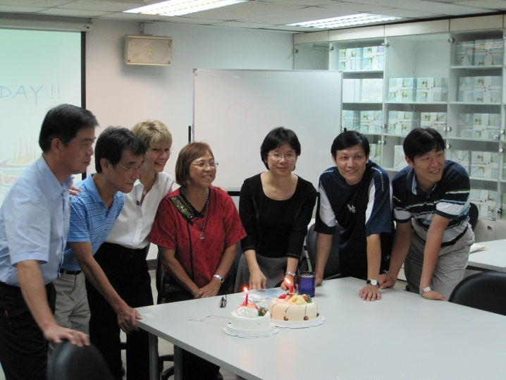
PETE Programmes in NTNU
Schedule
02/22 | 課程介紹與分組、教師生命史與未來的挑戰
03/01 | -
03/08 | Competence-based PE teaching與Physical Literacy
03/15 | Spectrum ch1, ch2 The command style(style A) text Discuss & Writing lesson plan
03/22 | The practice style (style B) text Discuss & Writing lesson plan
03/29 | The reciprocal style (style C) text Discuss & Writing lesson plan
04/05 | -
04/12 | The self-check style (style D) text Discuss & Writing lesson plan
04/19 | The inclusion style (style E) text Discuss & Writing lesson plan
04/26 | Reproduction cluster總研討及Spectrum ch8、ch9
05/03 | The guided discovery style (style F) text Discuss & Writing lesson plan
05/10 | The convergent style (style G) text Discuss & Writing lesson plan
05/17 | The divergent style (style H) text Discuss & Writing lesson plan
05/24 | The individual program-learner’s design (style I) text Discuss & Writing lesson plan
05/31 | The learner-initiated style (style J) text Discuss & Writing lesson plan
06/07 | 期末總複習暨素養導向課程設計探究
06/14 | -
06/21 | Final exam
Sport Pedagogy
PE Teaching Practicum

Slide 11
PETE Programmes in NTNU
Transformation
Storage
Retrieval
Sport Pedagogy
PE Teaching Practicum
Task
text reading
Presentation
Writing lesson plan
Micro teaching (Video)
Porfolio
Comparison
Discussion
text reading
Presentation
①
②

Slide 12
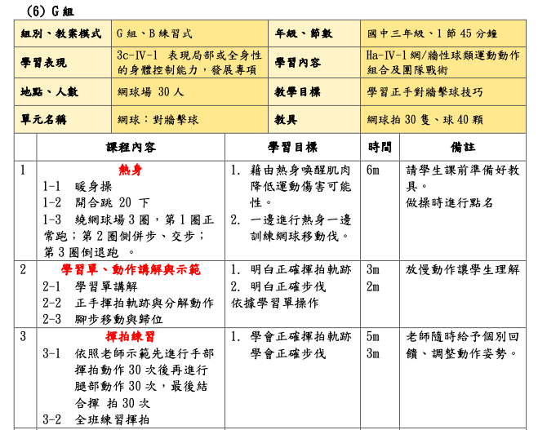
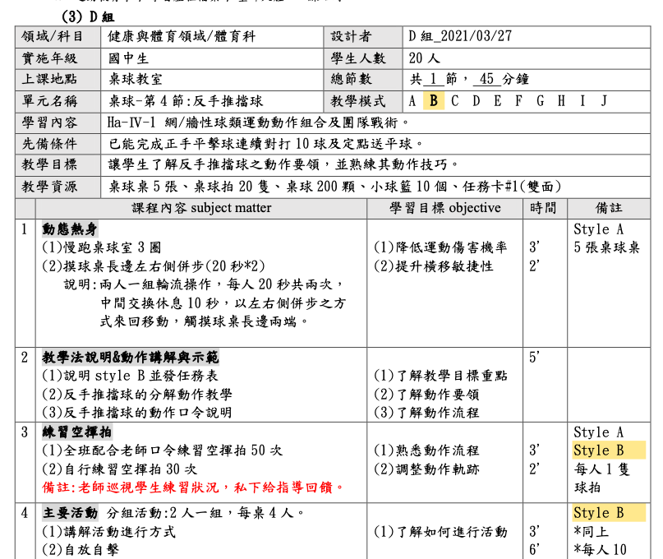
PETE Programmes in NTNU
Storage
Transformation
Retrieval
PE Teaching Practicum
Sport Pedagogy
PE Teaching Practicum
Task
text reading
Presentation
Writing lesson plan
Micro teaching (Video)
Porfolio

Slide 13
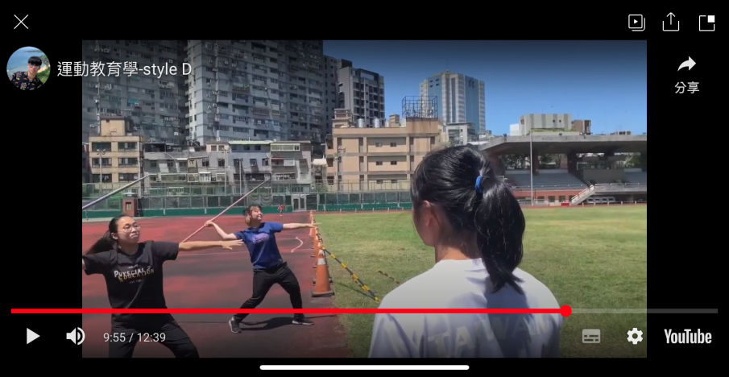
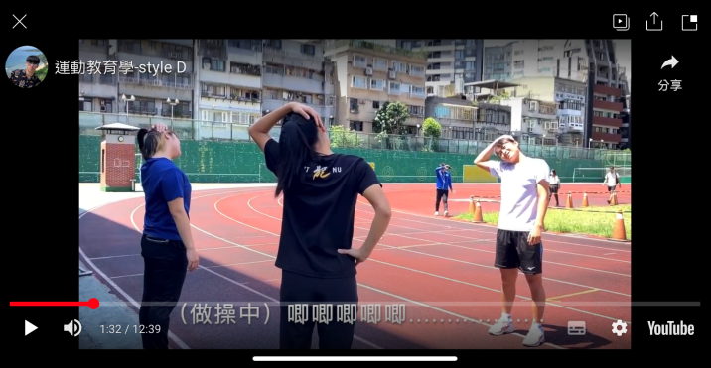
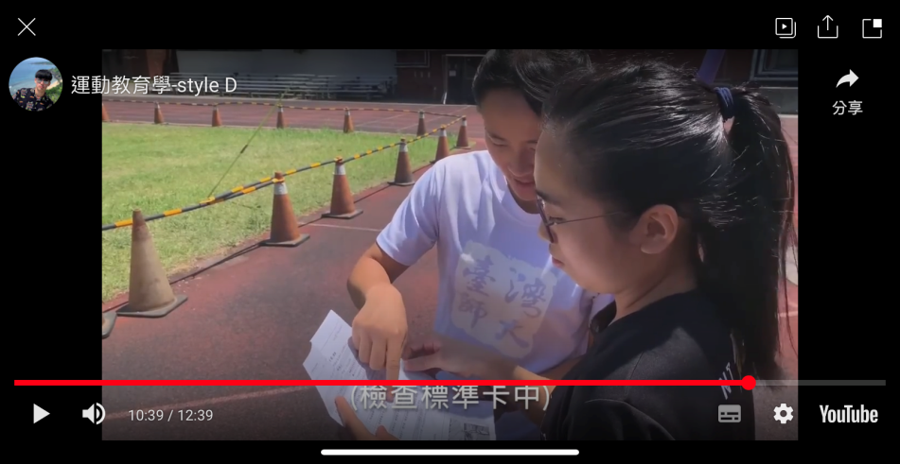
PETE Programmes in NTNU
Storage
Transformation
Retrieval
PE Teaching Practicum
Sport Pedagogy
Task
text reading
Presentation
Writing lesson plan
Micro teaching (Video)
Porfolio

Slide 14
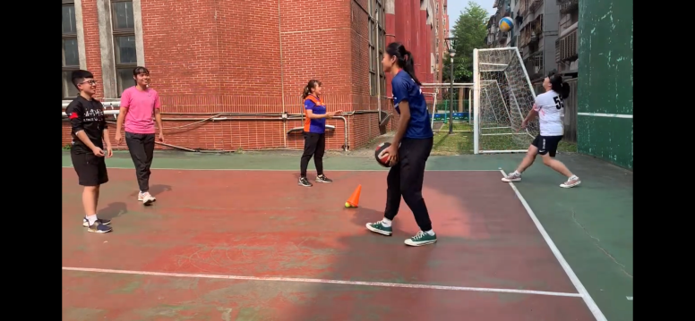
PETE Programmes in NTNU
Retrieval
Storage
Transformation
PE Teaching Practicum
Reflection

Slide 15
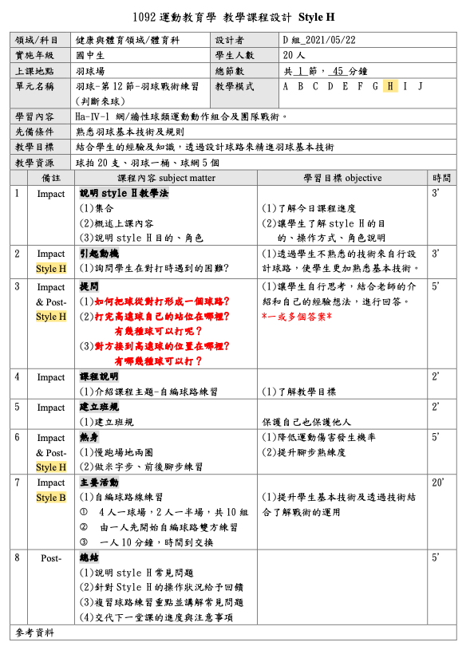
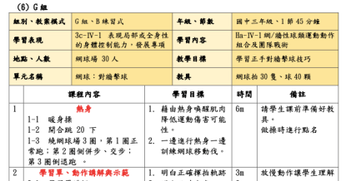
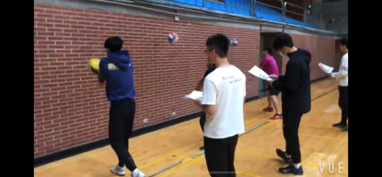
PETE Programmes in NTNU
Retrieval
Storage
Transformation
Reflection
Revise

Slide 16
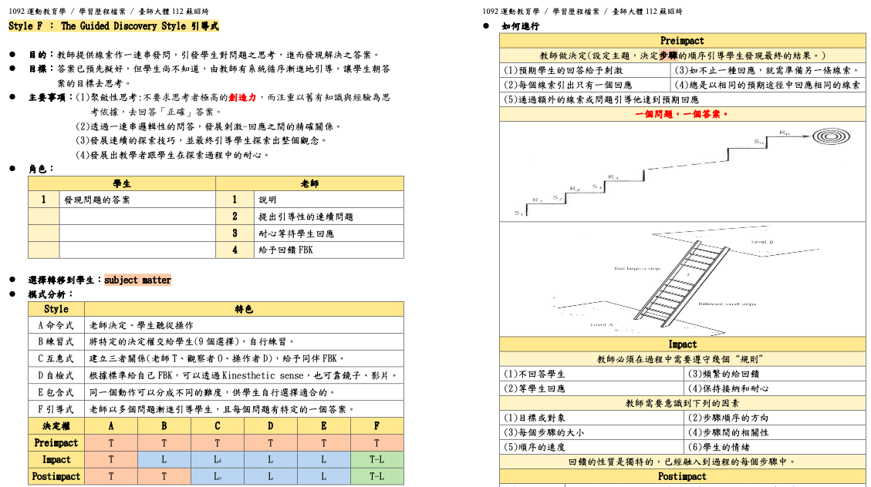
PETE Programmes in NTNU
Storage
Transformation
Retrieval
Sport Pedagogy
PE Teaching Practicum
Porfolio
Notes
Learning Sheet
Power Point
Writing lesson plan
Micro teaching (Video)
Reflection
final exam
Peer/ self- assessment
suggestion

Slide 17
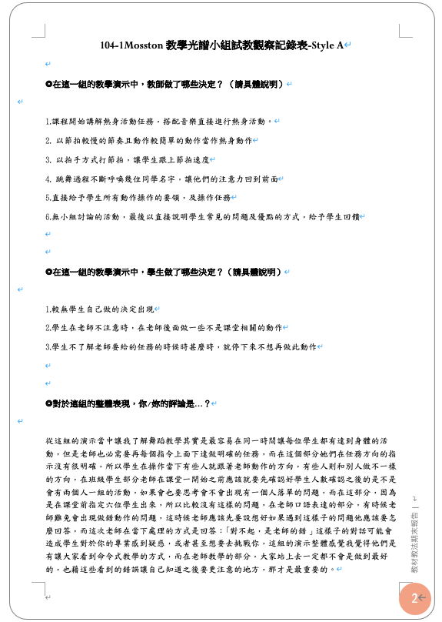
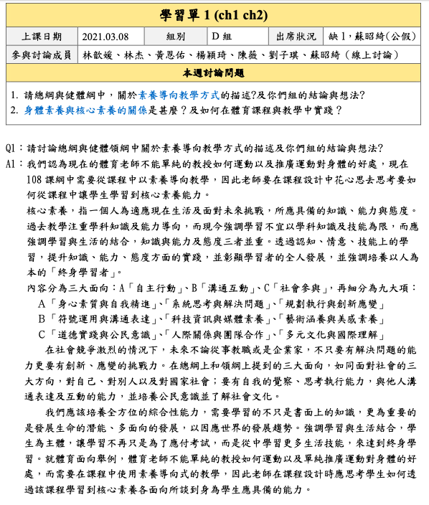
PETE Programmes in NTNU
Storage
Transformation
Retrieval
Sport Pedagogy
PE Teaching Practicum
Porfolio
Notes
Learning Sheet
Power Point
Writing lesson plan
Micro teaching (Video)
Reflection
final exam
Peer/ self- assessment
suggestion

Slide 18
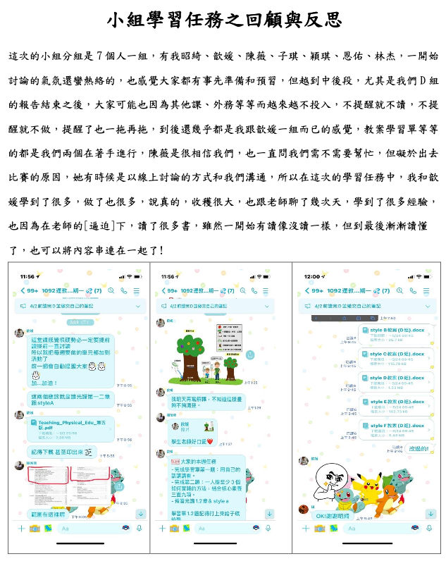
PETE Programmes in NTNU
Storage
Transformation
Retrieval
Sport Pedagogy
PE Teaching Practicum
Porfolio
Notes
Learning Sheet
Power Point
Writing lesson plan
Micro teaching (Video)
Reflection
final exam
Peer/ self- assessment
suggestion

Slide 19
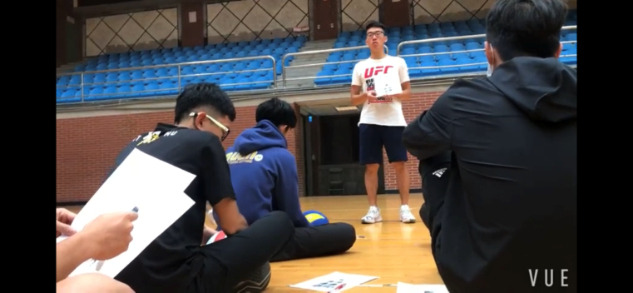
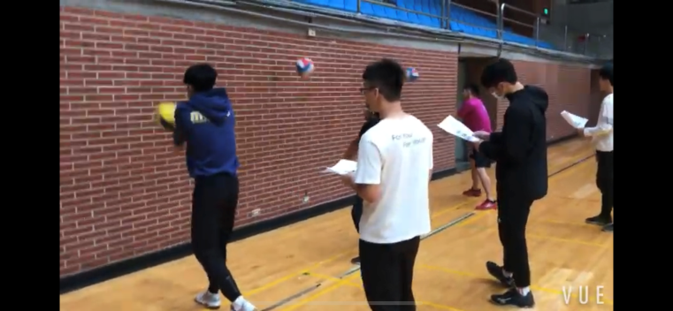
PETE Programmes in NTNU
Storage
Transformation
Retrieval
Sport Pedagogy
PE Teaching Practicum
Porfolio
Notes
Learning Sheet
Power Point
Writing lesson plan
Micro teaching (Video)
Reflection
final exam
Peer/ self- assessment
suggestion

Slide 20
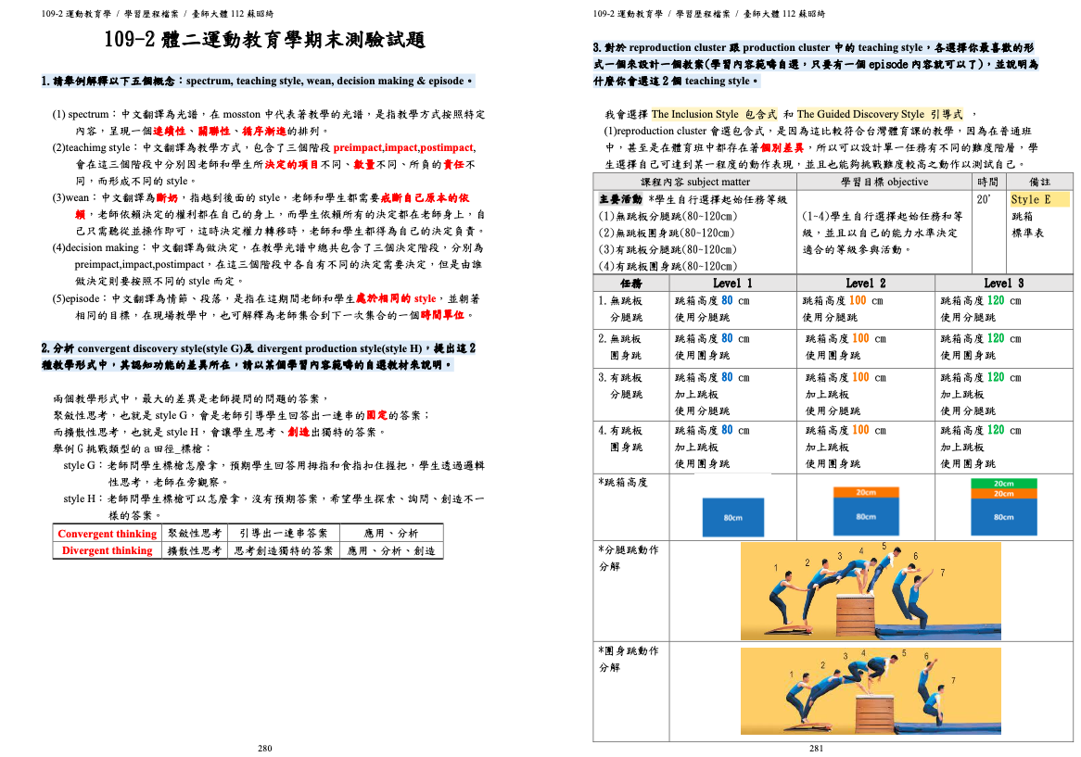
PETE Programmes in NTNU
Storage
Transformation
Retrieval
Sport Pedagogy
PE Teaching Practicum
Porfolio
Notes
Learning Sheet
Power Point
Writing lesson plan
Micro teaching (Video)
Reflection
final exam
Peer/ self- assessment
suggestion

Slide 21
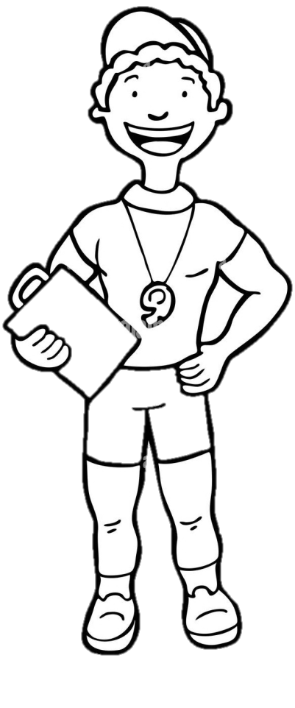
Future
Sport Pedagogy
This is just one stop of whole journey….

Slide 22
Sport Pedagogy
PE Teaching Practicum
NTNU
Thank you for the listening

